Slide 2
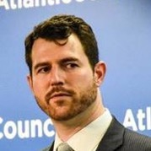
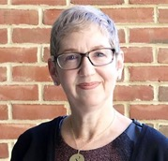
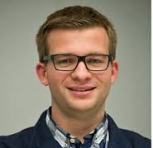
DiMe Virtual Journal Club
Wednesday, October 30th at 11 AM ET
Suzanne Schwartz, MD
CDRH, FDA
Beau Woods
I am the Cavalry
Hannes Molsen
Drägerwerk AG & Co. KGaA

Slide 4
Hippocratic Oath for Connected Medical Devices

Slide 5
Links to Additional Resources
I Am The Cavalry
The Case for a Hippocratic Oath for Connected Devices: Viewpoint
FDA Medical Device Safety Action Plan: Protecting Patients, Promoting Public Health
DRAFT FDA Guidance: Content of Premarket Submissions for Management of Cybersecurity in Medical Devices
FDA Patient Engagement Advisory Committee Meeting on “Cybersecurity in Medical Devices: Communication That Empowers Patients” and meeting materials
OWASP Secure Medical Device Deployment Standard
#wehearthackers
Biohacking Village
CyberMed Summit
NTIA multi-stakeholder process on software component transparency (SBOM)
FDA Voice Blog (pending)

Slide 6
Co-Designing Mental Health Apps with Patient Populations Monday, November 4 at 11am ET
Presenter:
Karen Fortuna, PhD, MSW | Assistant Professor of Psychiatry, Geisel School of Medicine, Dartmouth College
Presenter:
Robert Walker | Office of Recovery and Empowerment, Massachusetts Department of Mental Health
Moderator:
Rachel Chasse, MS | Digital Medicine Society

Slide 7
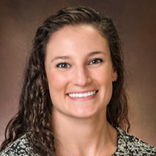
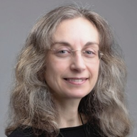
DiMe Virtual Journal Club
Tuesday, November 12th at 12 PM ET
Christine Manta
Elektra Labs
Simona Carini
Open mHealth
Dan Gotlieb
FHIR Healthcare
and Data Standards

Slide 8
www.dimesociety.org/index.php/membership

