Slide 1
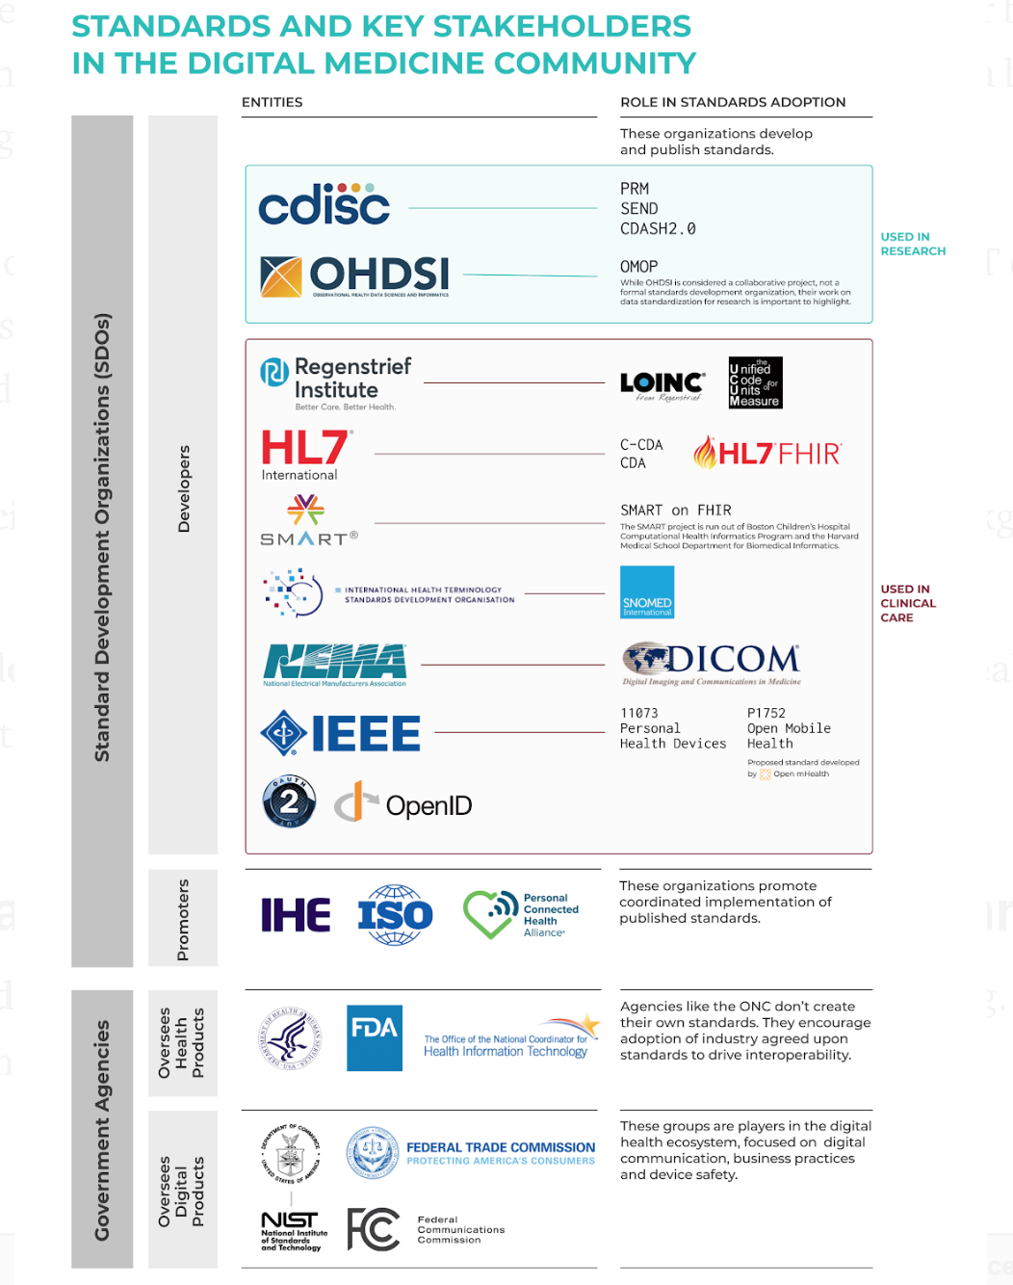
DiMe Virtual Journal Club
Tuesday, November 12th at 9amPT/12pmET
Digital Medicine Standards 101
Christine Manta
DiMe, Elektra Labs
Dan Gottlieb
SMART on FHIR
Simona Carini
Open mHealth
Notes:
We can collect so much more health data than ever before with the use of sensors and apps.
Integrating the data from digital tools into electronic health records is a really important step towards making this data useful for clinicians, researchers and patients.
So how do we get there? Interoperability and implementing standards that actually work has been a constant challenge for healthcare. With this new influx of data from digitals tools, we risk further burdening the system with untrustworthy and siloed data. So where do we begin this standards conversation for digital medicine?

Slide 2
Notes:
As a starting point, we developed this graphic to show key stakeholders and relevant standards for our community to be familiar with. This is far from an exhaustive list---according to the ONC there are at least 40 SDOs involved in health IT standards.
but it distills the government agencies, standard development organization and different types of standards that are commonly used today.
The graphic has been updated since the blog posts original release in September. SMART and SMART on FHIR. Added P1752 Open Mobile Health workgroup that IEEE and Open mHealth started in 2017 that we will discuss more in detail today

Slide 3
Continuous Digital Monitoring of Walking Speed in Frail Elderly Patients: Non-interventional Validation Study and Longitudinal Clinical Trial
December 12, 2019 12pm ET / 9am PT
Iuean Clay
CMO, Byteflies
Adjunct Professor, CWRU

